Slide 1
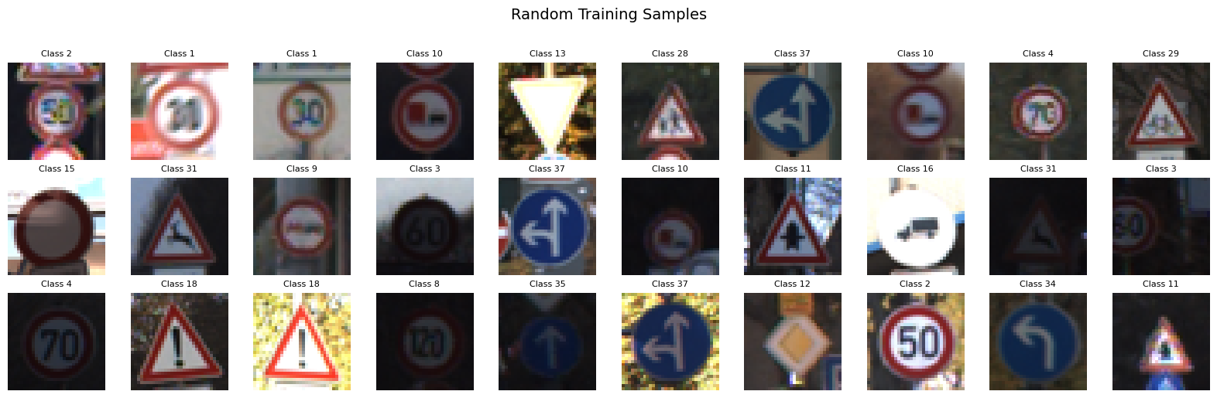
GTSRB
German Traffic Sign Recognition Benchmark
Model Comparison Report
Comparing KNN, SVM, Custom CNN, and ResNet-50
on Traffic Sign Classification
Kareem Abdelrehiem, Samuel Cordova

Slide 2
1. Project Introduction and Goals
This project presents a comprehensive comparison of four machine learning algorithms applied to the German Traffic Sign Recognition Benchmark (GTSRB) dataset. Traffic sign recognition is a critical component of autonomous driving systems and advanced driver-assistance systems (ADAS), making it a highly relevant real-world classification challenge.
The primary goals of this analysis are:
• Evaluate and compare the performance of two traditional machine learning models (KNN and SVM) against two deep learning architectures (CNN and a pre-trained ResNet-50).
• Perform hyperparameter tuning for each model using grid search or manual configuration search to find optimal settings.
• Assess models on standard classification metrics: Accuracy, Precision, Recall, and F1-Score.
• Compare training time efficiency alongside classification performance.
• Determine which approach offers the best trade-off between accuracy and computational cost for this image classification task.

Slide 3
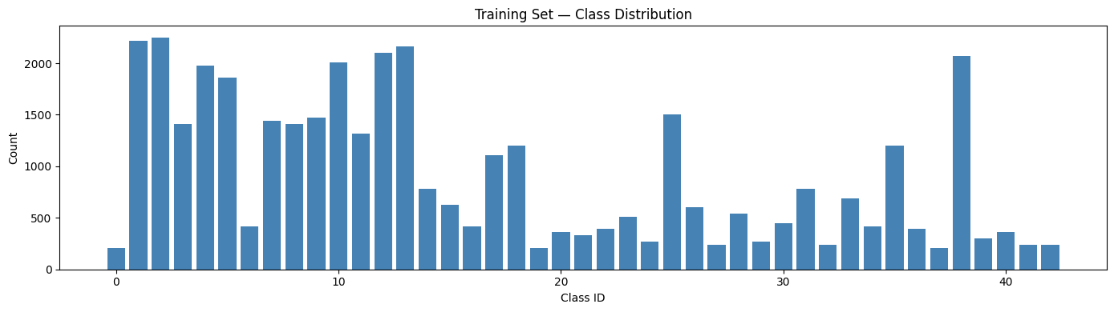
2. Dataset Description
The German Traffic Sign Recognition Benchmark (GTSRB) is a widely used, large-scale, multi-class image classification dataset. It features photographs of German traffic signs taken in varied real-world conditions (lighting, weather, occlusion, and viewing angles).
Property | Details
Total Training Images | 39,209
Total Test Images | 12,630
Number of Classes | 43
Image Size (resized) | 32 × 32 × 3 (RGB)
Class Examples | Speed limits, stop signs, yield, priority, no entry, etc.
The target variable is the traffic sign class label (0-42, 43 categories). The task is classification. Challenges include high inter-class similarity, significant intra-class variation, and class imbalance.

Slide 4
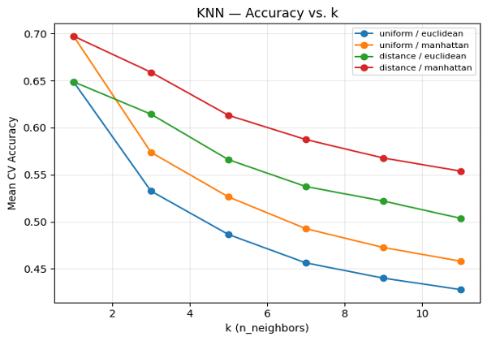
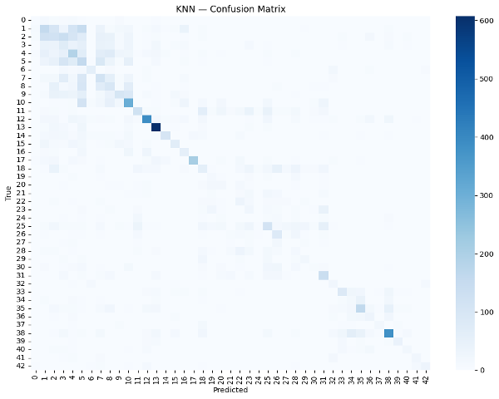
3. Model Implementation
Four models were implemented and evaluated. For traditional ML models (KNN and SVM), images were flattened to 1-D vectors of 3,072 features (32×32×3) and standardized using StandardScaler. For deep learning models (CNN and ResNet-50), images were kept in their original 4-D tensor format and normalized to [0, 1].
3.1 K-Nearest Neighbours (KNN)
Tuning Strategy: GridSearchCV with 3-fold stratified cross-validation over 24 candidate configurations.
Hyperparameter | Values Searched | Best Value
n_neighbors | 1, 3, 5, 7, 9, 11 | 1
weights | uniform, distance | uniform
metric | euclidean, manhattan | manhattan
Best CV Accuracy: 0.6974
Test Accuracy: 0.3378
F1-Score: 0.3446
Training Time: 95.3 seconds

Slide 5
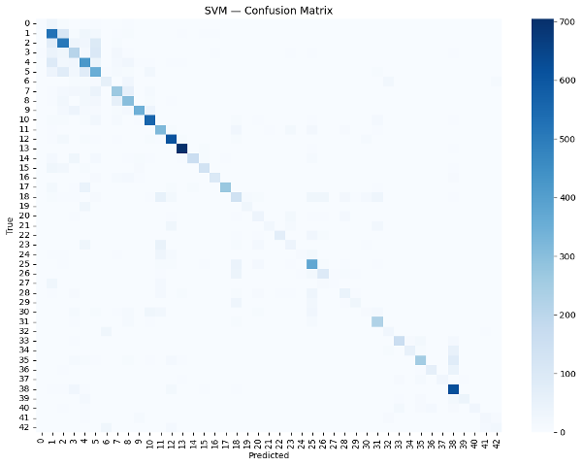
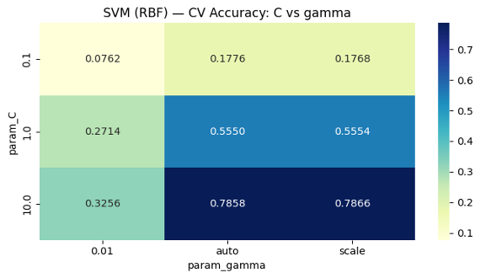
3.2 Support Vector Machine (SVM)
Tuning Strategy: GridSearchCV with 3-fold stratified cross-validation over 18 candidate configurations.
Hyperparameter | Values Searched | Best Value
C | 0.1, 1, 10 | 10
gamma | scale, auto, 0.01 | scale
kernel | rbf, poly | rbf
Best CV Accuracy: 0.7866
Test Accuracy: 0.6554
F1-Score: 0.6465
Training Time: 444.9 seconds

Slide 6
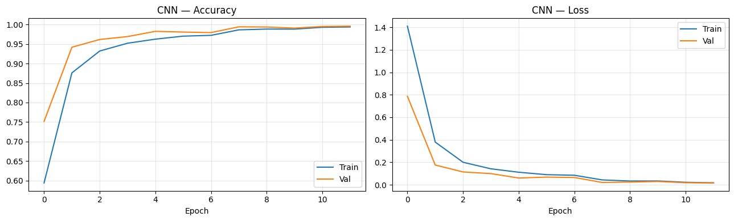
3.3 Custom Convolutional Neural Network (CNN)
Tuning Strategy: Manual search over learning rate and dropout rate combinations with data augmentation (random flip, rotation, zoom, brightness jitter).
Hyperparameter | Values Searched | Best Value
learning_rate | 1e-3, 5e-4 | 5e-4
dropout_rate | 0.3, 0.5 | 0.3
epochs | 12 | 12
Test Accuracy: 0.9266
F1-Score: 0.9266
Training Time: 71.6 seconds

Slide 7
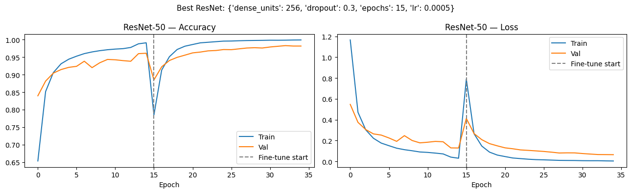
3.4 ResNet-50 (Transfer Learning)
Tuning Strategy: Two-stage training: frozen feature extraction with fresh classification head, followed by fine-tuning the last 30 layers. Images resized to 64×64 with ImageNet preprocessing.
Hyperparameter | Values Searched | Best Value
dense_units | 128, 256 | 256
dropout | 0.3, 0.5 | 0.3
learning_rate | 1e-3, 5e-4 | 5e-4
epochs | 15 | 15
Test Accuracy: 0.7280
F1-Score: 0.7250
Training Time: 269.0 seconds

Slide 8
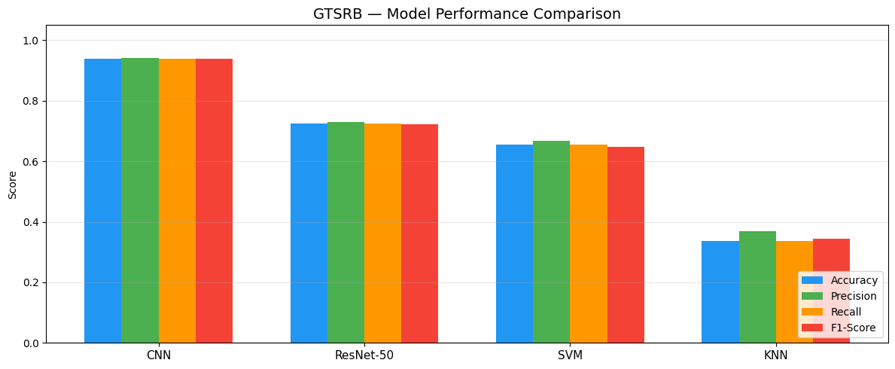
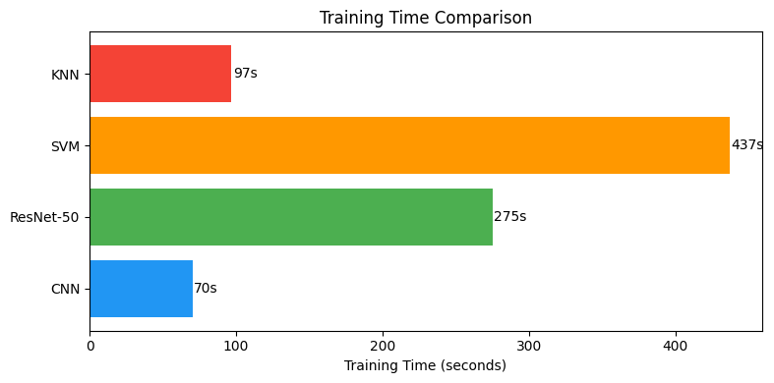
4. Performance Visualization
Comparison of all four models across key performance metrics and training efficiency.
4.1 Final Comparison Table
Model | Accuracy | Precision | Recall | F1-Score | Train Time (s)
CNN | 0.9266 | 0.9298 | 0.9266 | 0.9266 | 71.6
ResNet-50 | 0.7280 | 0.7275 | 0.7280 | 0.7250 | 269.0
SVM | 0.6554 | 0.6664 | 0.6554 | 0.6465 | 444.9
KNN | 0.3378 | 0.3695 | 0.3378 | 0.3446 | 95.3

Slide 9
5. Conclusions
5.1 Key Findings
• CNN is the clear winner with 92.66% accuracy and an F1-score of 0.9266, while training in only 71.6 seconds — the best accuracy-to-time trade-off among all models.
• ResNet-50 under-performed expectations (72.80% accuracy). Resizing tiny 32×32 GTSRB images to 64×64 and using ImageNet-pretrained weights offered limited benefit due to the significant domain gap between ImageNet and traffic signs.
• SVM delivered reasonable traditional-ML results (65.54%) using an RBF kernel with C = 10, but flattening images to 1-D vectors discards the spatial structure that CNNs naturally exploit.
• KNN struggled the most (33.78%) because pixel-level Euclidean/Manhattan distance is a poor similarity metric for a 43-class image classification task.
5.2 Insights
• Spatial information matters: flattening images into 1-D vectors fundamentally limits traditional ML models (KNN, SVM) for image tasks, while CNNs preserve and leverage spatial structure through convolutional filters.
• Data augmentation (rotation, zoom, brightness jitter) contributed significantly to the CNN's strong generalization performance.
• Transfer learning is not always superior: when the source domain (ImageNet) is very different from the target domain (traffic signs) and input resolution is severely limited, a well-designed custom architecture can outperform a pre-trained heavyweight model.
• A larger input resolution (224×224) and a longer fine-tuning schedule could significantly improve ResNet-50's results in future work.

Slide 10
Final Conclusions
Rank | Model | Accuracy | Verdict
1 | Custom CNN | 92.66% | Best overall, highest accuracy, fastest training
2 | ResNet-50 | 72.80% | Limited by low resolution and domain gap
3 | SVM | 65.54% | Best traditional ML, but lacks spatial awareness
4 | KNN | 33.78% | Pixel distance is too naive for image classification
In conclusion, for the GTSRB traffic sign classification task, a custom CNN architecture with appropriate data augmentation delivers the best combination of accuracy and efficiency, and is the recommended approach for deployment in real-world traffic sign recognition systems.

Slide 11
Questions? … Thank you!

